Slide 1
Debian Electronics BOF
Bdale Garbee
Altus Metrum, LLC bdale@gag.com

Slide 2
Agenda
Progress / status reports
Questions on using electronics packages
Can we improve maintaining electronics tools in Debian?
https://wiki.debian.org/Teams/pkg-electronics

Slide 3
What is Debian Electronics?
https://wiki.debian.org/Teams/pkg-electronics
Packages used by electronics developers, including tools related to the development of embedded systems software
  Schematic capture
  Printed circuit board design
  Circuit and EM/RF simulation
  FPGA / ASIC development
  Cross-compilers and libraries, Arduino tools
  Embedded target debugging tools

Slide 4
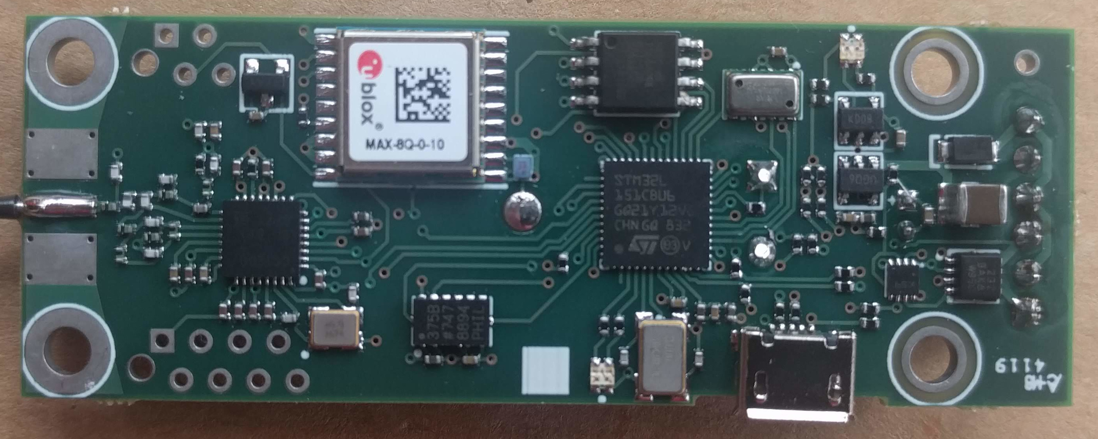
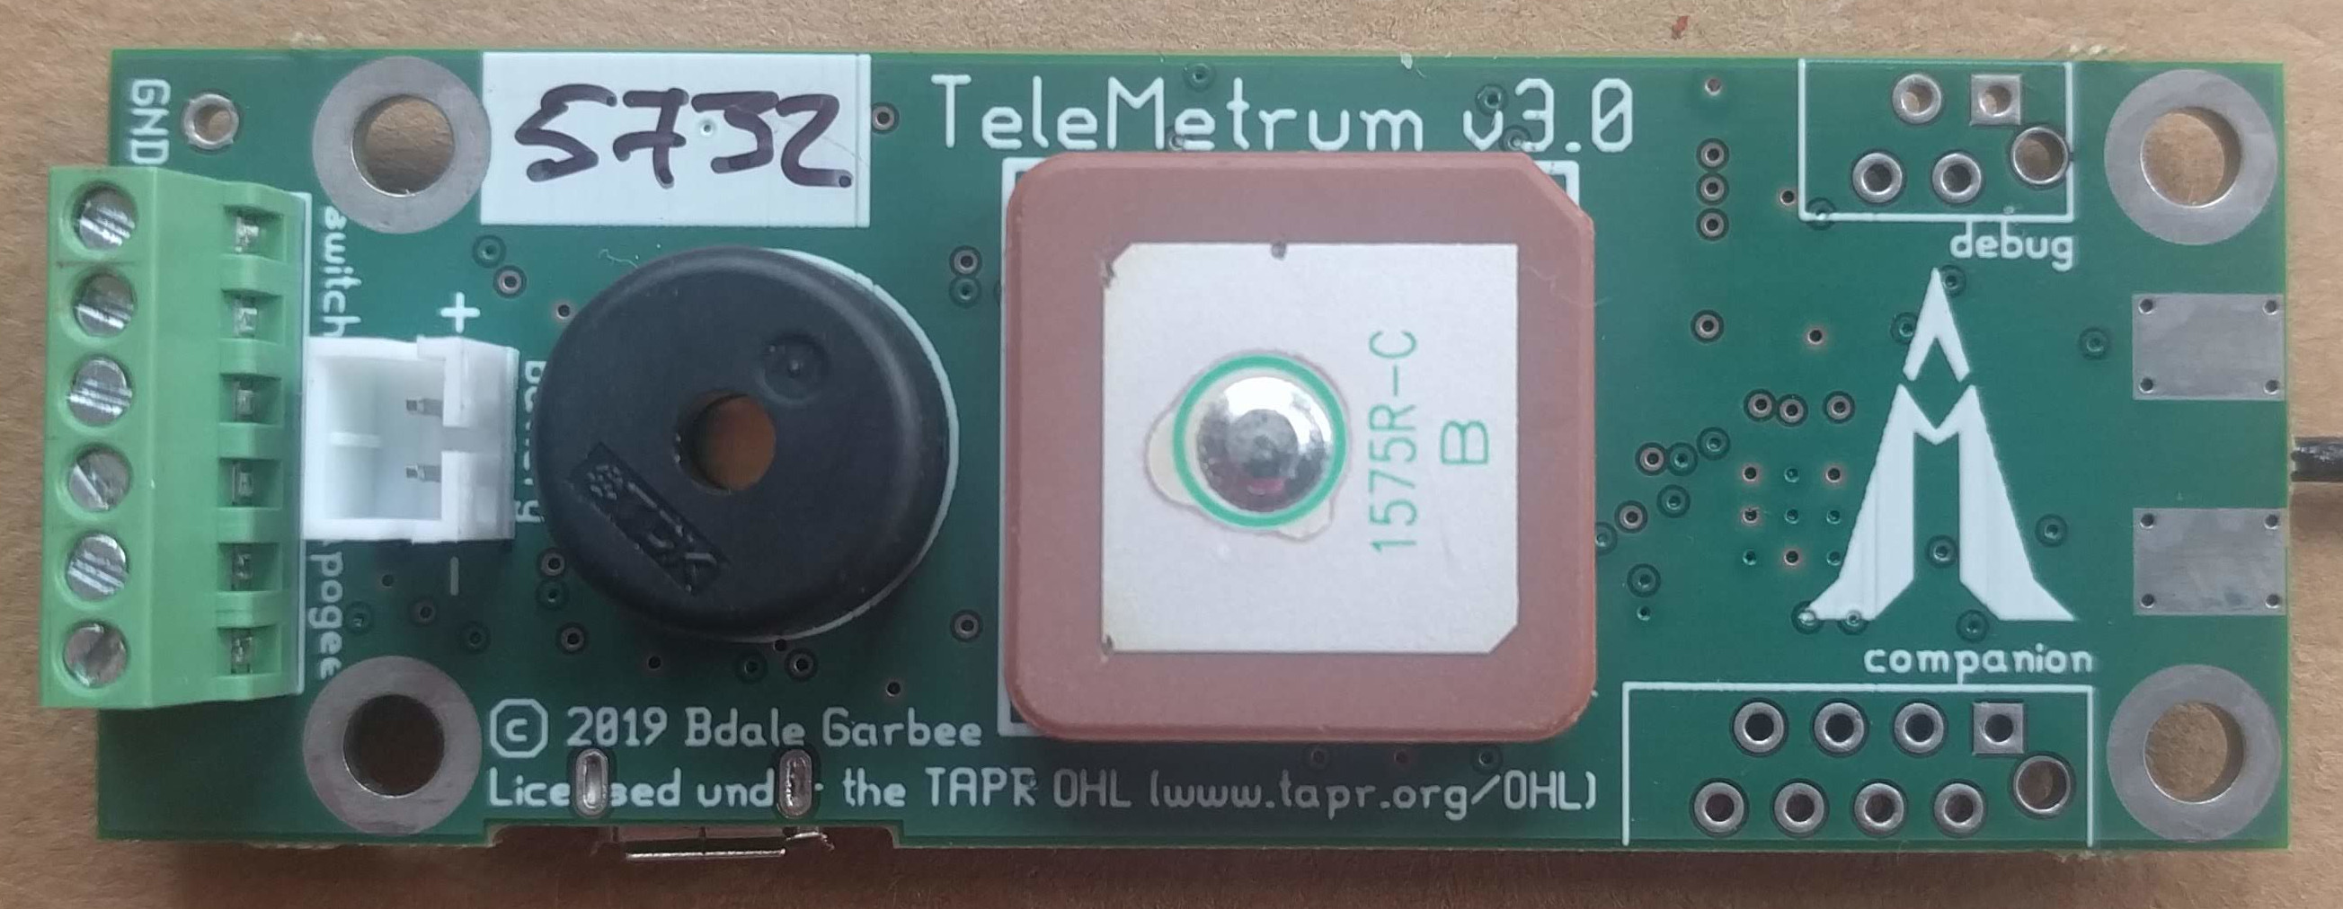

Slide 5
Work Happens on Salsa
https://salsa.debian.org/electronics-team
27 current members, more always welcome!
111 source packages on salsa
8 sub-groups for particular tool suites

Slide 6
Electronic Packages Bdale Maintains
gEDA is now dead upstream, use these forks:
  Lepton-eda (schematic capture)
  Ringdove suite
    sch-rnd (schematic capture)
    pcb-rnd (circuit board design)
    camv-rnd (gerber viewer)
    route-rnd (autorouter for pcb-rnd)
OpenEMS
  Abandoned by Science Team, re-packaging

Slide 7
Others With Things to Report?

Slide 8
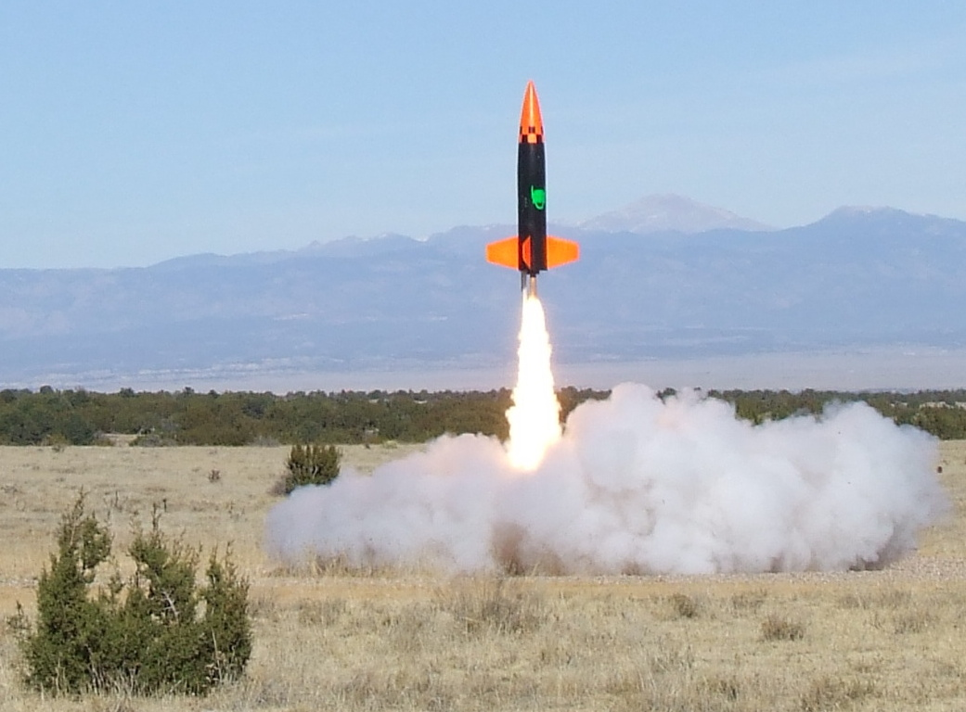
Questions?
bdale@gag.com
bdale on irc.oftc.net

